Slide 1
Sheldon Sixth Form Mr Spiers Miss Frater Laura Thomas and Penny Bradley
Year 13 Parent and Student forum
@sheldonsixthform

Slide 2
Welcome and overview
Wessex Inspiration Network (WIN) – revision support
UCAS – what next?
Non-UCAS – what next?
Exams and wellbeing
Key dates

Slide 3
MY STUDY SKILLS
UNDERSTAND HOW TO REVISE EFFECTIVELY

Slide 4
WHAT IS WIN?
WIN (Wessex Inspiration Network) is one of 29 regional partnerships within the Uni Connect Programme aiming to increase social mobility by raising awareness of Higher Education (HE) opportunities and progression pathways for young people.
WIN covers BANES, North Somerset and Wiltshire (excluding Swindon) and works closely with target schools and colleges to deliver workshops and events to encourage progression to Higher Education.

Slide 5
TODAY WE WILL:
Think about how you can make your revision effective
Plan a revision timetable
Explore revision strategies and techniques

Slide 6
How can you make revision effective?
Plan when and where you are going to revise
Plan how you are going to do it (which strategies are you going to use?)
Reflect and evaluate your progress

Slide 7
Walking the dog
Washing up
Football training
Helping round the house
On my phone (BE HONEST)
Netflix
Picking up my brother from after school club
First, plan when and where you are going to revise
Where Does
My Time Go?
Note down all activities you do daily outside of school
Note down all activities you do daily outside of school
Note down all activities you do daily outside of school

Slide 8
look at your exam timetable and start revising in that order
Leave yourself plenty of time! The more you can go over the information, the more you will remember it in your exams
Do you find in easier to start with the trickiest subjects/topics or the ones you find easier to give you confidence?
Think about who can support you – teachers, parents and carers

Slide 9
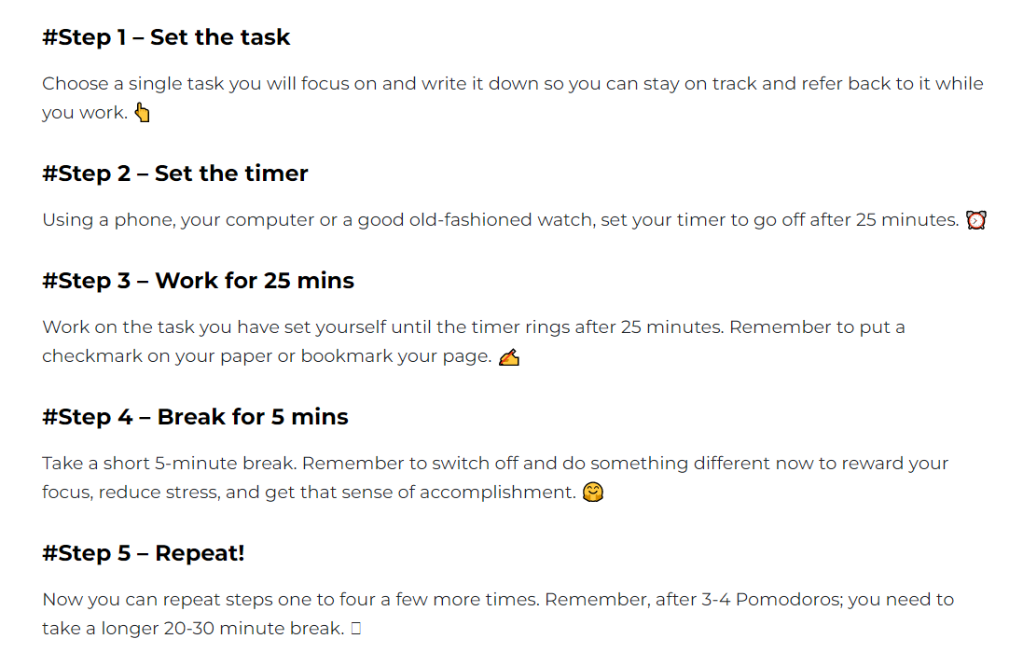
Top tips
Consider using the ‘Pomodoro technique’ to manage your time – if you find it hard to focus for long periods of time, this could really help you!
Notes:
The idea behind the method is that by breaking down the time into manageable chunks, you will be able to focus better on the task at hand, knowing you will soon have a break. Could this

Slide 10
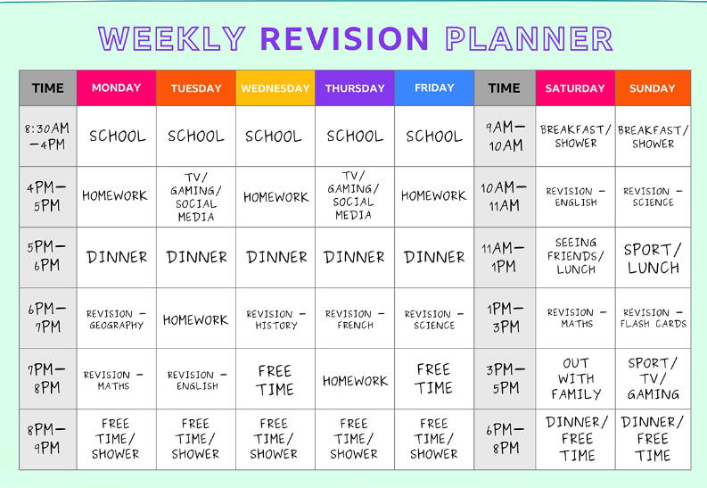
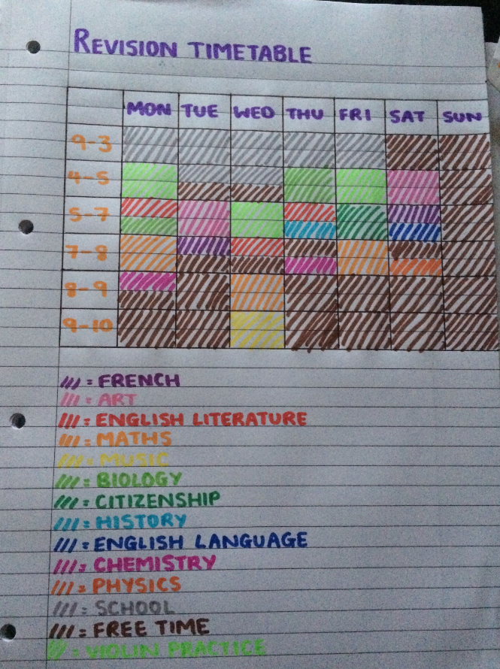
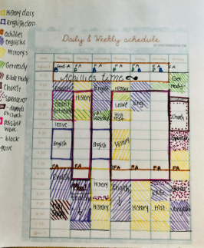
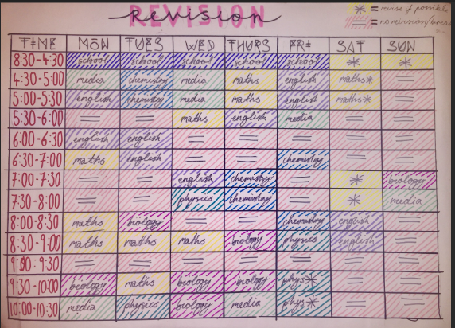
START BY PUTTING YOUR FREE TIME INTO YOUR PLANNER THEN ADD YOUR REVISION SESSIONS:
MAKE IT YOUR OWN

Slide 11
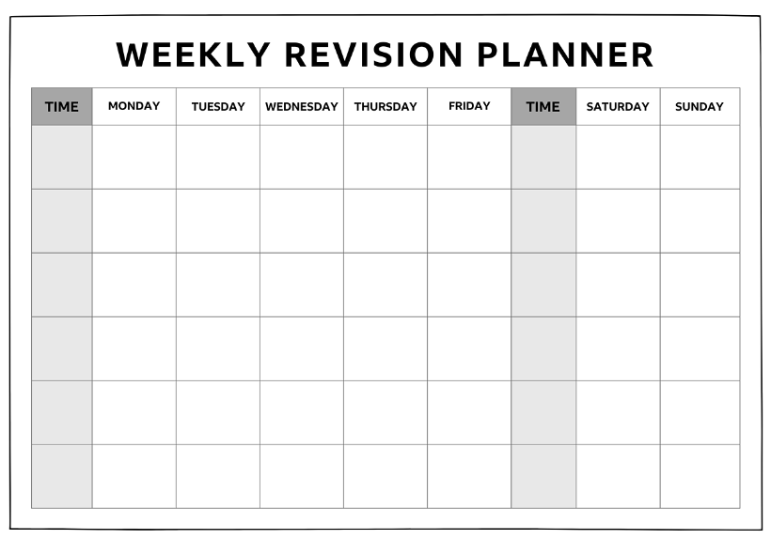

Slide 12
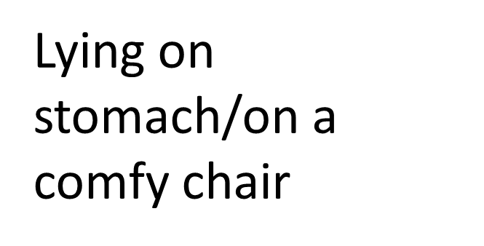
Where are you going to revise?
Consider where there is a quiet space to revise. Your room may not be the best place as it is good to separate your work and rest space
Some music in the background (instrumental)
Quiet space

Slide 13
Strategy 1
Feynman Technique – study method for students to learn through the act of teaching
4 Steps
1.Choose what you are going to learn about
2.Explain it in simple terms (like you would to a child. Remove any jargon and complexity)
3. Reflect and refine (Read it out loud as if to a child. If the explanation isn’t simple enough or sounds confusing, that’s a good indication that you need to reflect and refine.)
4. Organise and review (test it on someone, what did they get confused about? What questions did they ask? Once you are happy with your explanation add it to your notes or flashcard to refer back to)
Einstein

Slide 14
Your turn!
‘Explain’
In your pairs chose a subject and describe it in a minute.
Imagine your partner knows nothing about the subject.
How can you explain it in the simplest terms?
Explain climate change
Explain what a pandemic is
Explain how to make a cake
Explain your personality
Explain how you get to school
Notes:
How easy did they find this? If you can explain it simply to someone else, that demonstrates your understanding

Slide 15
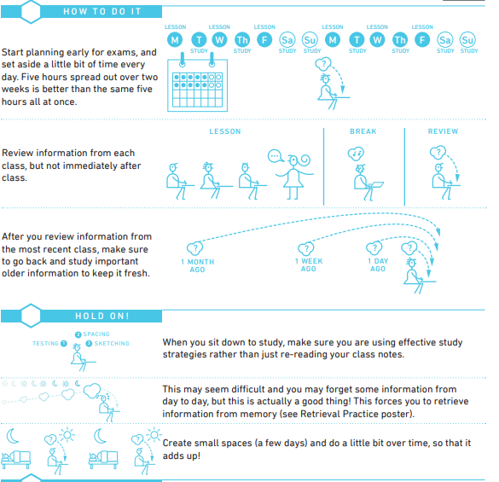
Spaced practice
Strategy 2
review, practice, recall, formulate and synthesize the same materials multiple times.
Video 0.42-1.38
How to Study Effectively for School or College [Top 6 Science-Based Study Skills] - YouTube

Slide 16
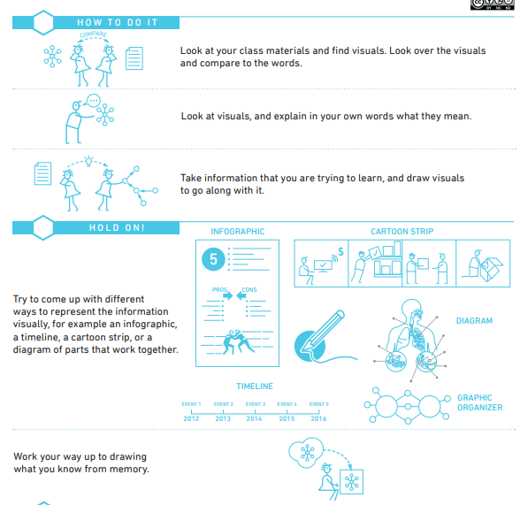
Dual coding
Strategy 3
Using visuals alongside information
Video: 5.33- 6.38

Slide 17
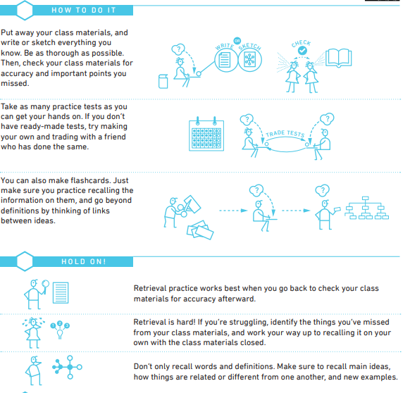
Retrieval Practice
Strategy 4
engage with the material in an active way rather than passive learning i.e. testing knowledge
Video: 6.38 - end

Slide 18
3 stages of metacognition
awareness and understanding of one's own thought processes.

Slide 19
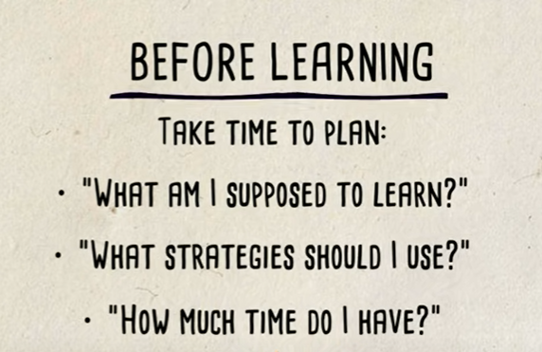
Stage 1

Slide 20
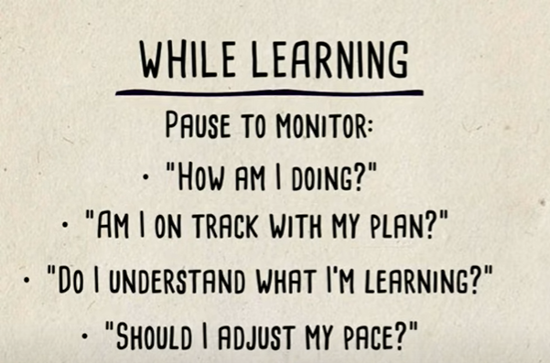
Stage 2

Slide 21
Stage 3

Slide 22
Want to
explore more?
Click into
Student Room

Slide 23
Thanks for listening
??
Any Questions
www.winncop.ac.uk

Slide 24
UCAS – what next?
Jan 25th deadline (internal 15th)
Firm and insurance
Feb 23rd – UCAS Extra opens
18th May – deadline for (most) university offers
8th June – deadline to make your F+I choices

Slide 25
UCAS – student finance: https://www.youtube.com/watch?v=xd4aDyNe3P8&t=23s
To secure payment in Sept there is usually a deadline end of May
02
You DO NOT need to have made your F+I choice to apply
03
You will need to know household income etc
04
Usually opens in April
01

Slide 26
Non-UCAS – what next?
There are no national / set deadlines!
Check social media
Careers newsletter
Amazing Apprenticeships Jan 17th
WIN – CVs and interviews – 7th Feb

Slide 27
Katie Witchell – kwitchell@sheldonschool.co.uk to make an appointment or you can drop-in to the Careers Hub near the hall on Thursday or Friday lunch times.
https://amazingapprenticeships.com/vacancies/
https://www.apprenticeships.gov.uk/influencers/resources-for-parents#
https://careerfinder.ucas.com/
https://pathwayctm.com/register/
https://www.findapprenticeship.service.gov.uk/
https://www.springpod.com/apprenticeships/opportunities

Slide 28
Exams and wellbeing
w/b Jan 30th exams continue – no lessons
02
Summer exams start – w/b 15th May
03
Summer exams end – contingency day 28th June
04
Jan 25th – internal exams start
01

Slide 29
Key dates
Jan 15th – internal UCAS deadline
Jan 17th - Higher/Degree Apprenticeships session
Jan 25th – UCAS deadline and internal exams start
w/b 30th Jan – internal exams – no lessons
Feb 7th – WIN CV and interview workshop
w/b 6th Feb - NAW
March 30th – interim report home
April 25th – F2F parents evening
Mid May – leavers’ day – tbc
End of May? – student finance deadline - tbc
June 8th – deadline for UCAS F+I choices
July 5th – Yr13 ball
August 17th – results day

Slide 30
Sheldon Sixth Form
Questions?
@sheldonsixthform
Weekly notes

